Slide 1

Wanting and Liking within the Human Ventral Striatum: a “high-resolution” fMRI study
Eva Pool, Charlotte Prévost, Sylvain Delplanque, Tobias Brosch, Patrik Vuilleumier,
David Sander

Slide 2
Background & Previous Studies
Animals
Humans
Reward Processing
Wanting
Effort before
PIT
Human-PIT
Liking
Pleasure during
Orofacial expressions
Hedonic experience
Berridge & Robinson (2003). Trends in Neuroscience

Slide 3
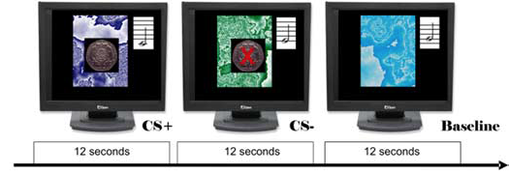
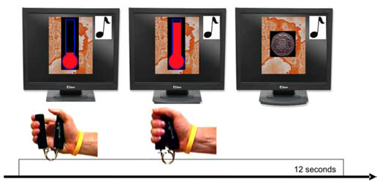
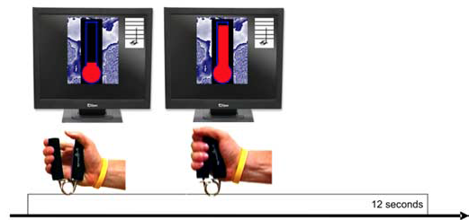
Preliminary Data: Human PIT Odors
PIT with Monetary Reward
PIT with Olfactory Reward
Talmi et al., (2008). Journal of Neuroscience; Pool et al., (2015). JEP:ALC

Slide 4
Preliminary Data: Human PIT Odors
Transfer with Monetary Reward
Transfer with Olfactory Reward
Talmi et al., (2008). Journal of Neuroscience; Pool et al., (2015). JEP:ALC

Slide 5
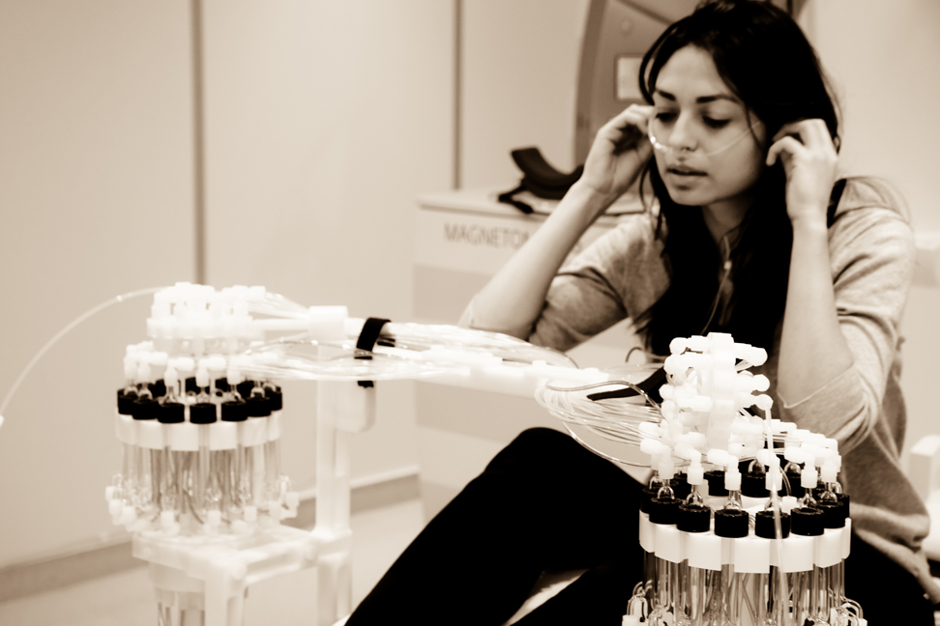
Preliminary Data: Pleasure Odors
Did you find the odor pleasant ?
Extremely Unpleasant
Extremely
Pleasant
Delplanque et al., (2008); Kringelbach et al., (2008); Pichon et al., (in prep)

Slide 6
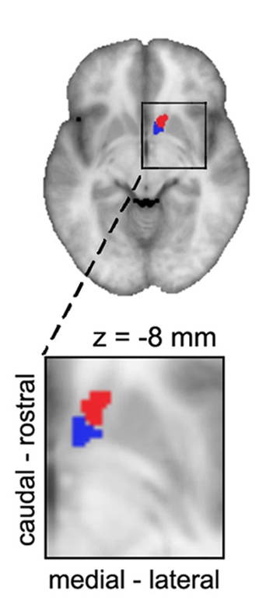
Aims of the Current Study
Animals
Humans
Reward Processing
Wanting
Effort before
NAcc
core
NAcc caudal and medial
Liking
Pleasure during
Hotspot NAcc shell
NAcc rostral and lateral
High-Resolution
Baliki et al. (2013). Journal of Neuroscience

Slide 7
Experimental Procedure
Day 1 (outside the scanner)
Manipulation check
Liking
Intensity
Select neutral odor

Slide 8
Experimental Procedure
Day 2 (in the scanner)
5 min
Learning reminders
PIT (15 trials*CS)
CS+; CS-; Baseline
20 min
20 min
Pleasure (15 trials*odor)
Choco; neutral; control
Liking
Intensity

Slide 9
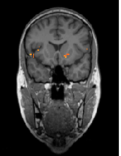
Technical Parameters
Sequence
(from Prévost et al., 2012)
26 Partial EPI
TR 2400 TE 41
1.8 voxel isometric
+ T1; Gradient field maps; Whole Brain
Knutson et al., (2014)
Other resources
Timing
Olfactometer
24 participants
Biopac (PPU; Belt; Handgrip)
1h45 per session
MRI operator (Bruno Bonet)
May-September
Prévost et al., (2012). Journal of Neuroscience

Slide 10
Planned Analyses
PIT
CS+
CS-
CS+
CS-
U
Behavioral PIT
Hedonic Pleasure
Chocolate
Neutral
Chocolate
Neutral
U
Behavioral Pleasantness
Prévost et al., (2012); Talmi et al., (2008); Kringelbach et al., (2008)

Slide 11
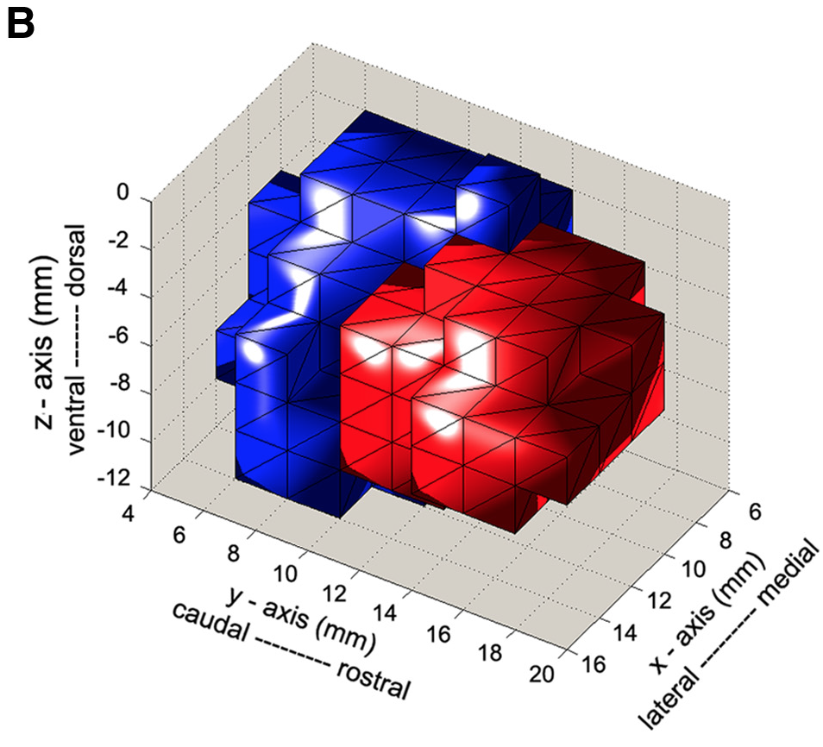
Predictions
NAcc caudal and medial
(core)
Will correlate more with the behavioral index of the PIT than with the behavioral index of hedonic pleasure
NAcc rostral and lateral
(shell)
Will correlate more with the behavioral index of hedonic pleasure than with the behavioral index of the PIT
Baliki et al. (2013). Journal of Neuroscience

Slide 12

Thank you for your attention

